Slide 1

Senior Project Website Version 5
FINAL PRESENTATION
Jacek Kopczynski: Developer
Yamel Peraza: developer
MADOUD Sadjadi: Mentor
MADOUD Sadjadi: Product owner
CIS 4911 Senior Project
School of Computing and Information Sciences
Florida International University
April 1st, 2015
Notes:
brief

Slide 2
Problem Definition
SPWS does not support the request of Virtual machines
Current method of requesting virtual machines is:
Time consuming
Error prone
Proposed system will extend the usability of the SPWS
Students can customize their virtual machines
Head professor can manage virtual machine requests
SPWS does not have functionality for:
Including students with incomplete grade
Forgotten password
Easy environment setup for future versions of the project
Notes:
Introduce SPW before this CONTEXT

Slide 3
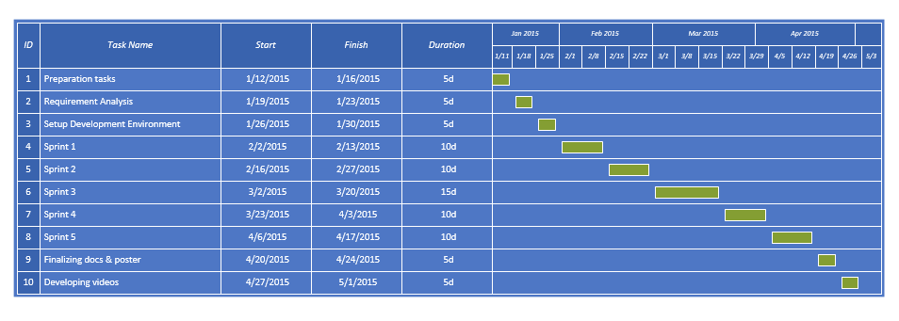
Project Management
Notes:
brief

Slide 4
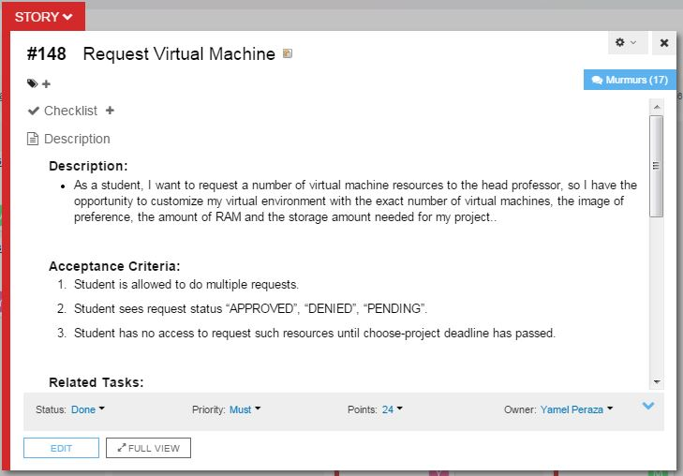
User stories

Slide 5
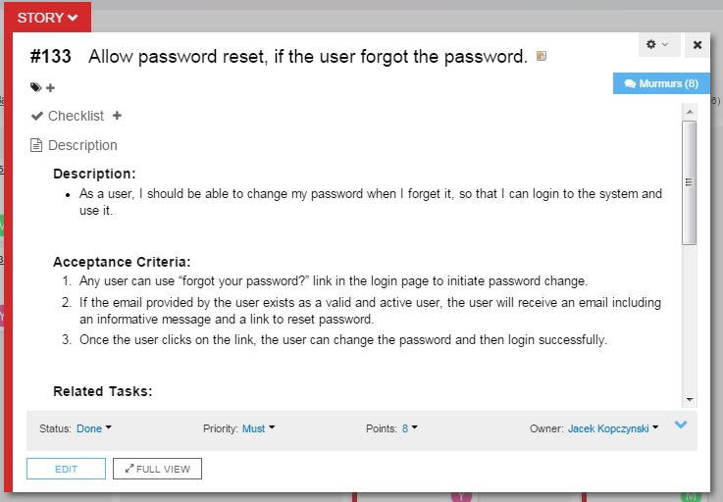
User stories

Slide 6
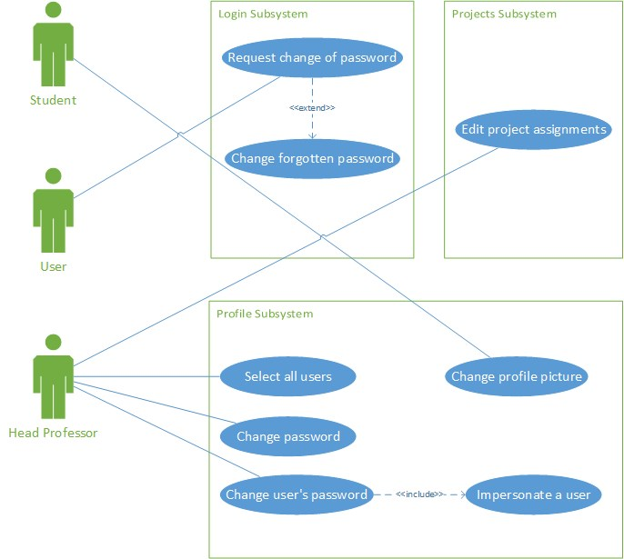
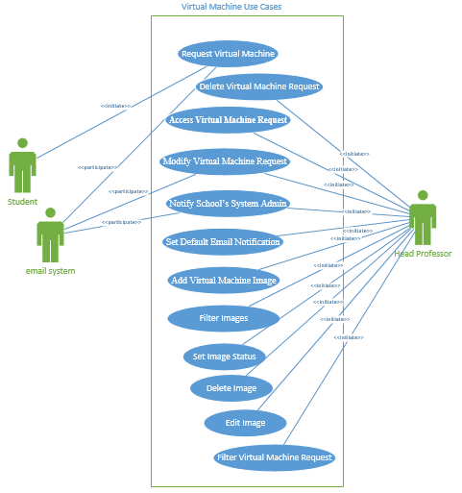
Use Case Diagram
Notes:
brief

Slide 7
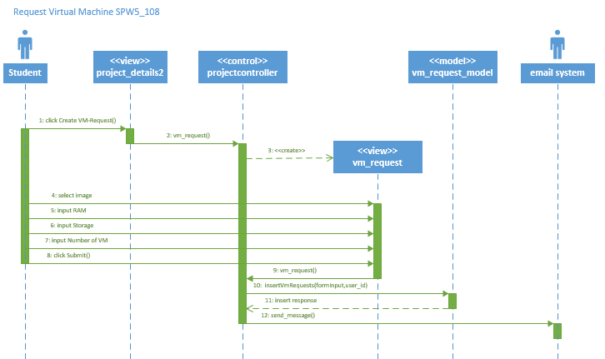
Sequence Diagrams

Slide 8
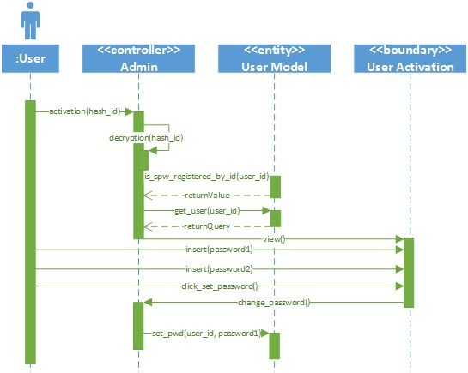

Slide 9
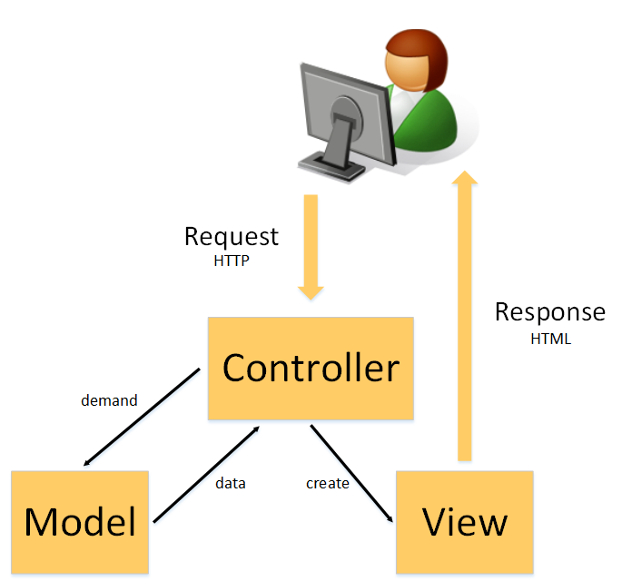
System Design – System Decomposition
Primary Architecture: MVC
Model: Maintains domain knowledge
View: Displays information to user.
Controller: Manages sequence of interactions with users
Secondary Architecture: Three-Tier
Similar to MVC with “presentation tier” (view), “domain logic tier” (controller), and “data-storage tier” (model)
But presentation and data-storage tiers do not interact its explicitly presentation to/from domain logic to/from data storage
NOTE: No change from V4
Notes:
brief

Slide 10
System Design - System Deployment
Deployment Diagram (same as V4)
Notes:
brief

Slide 11
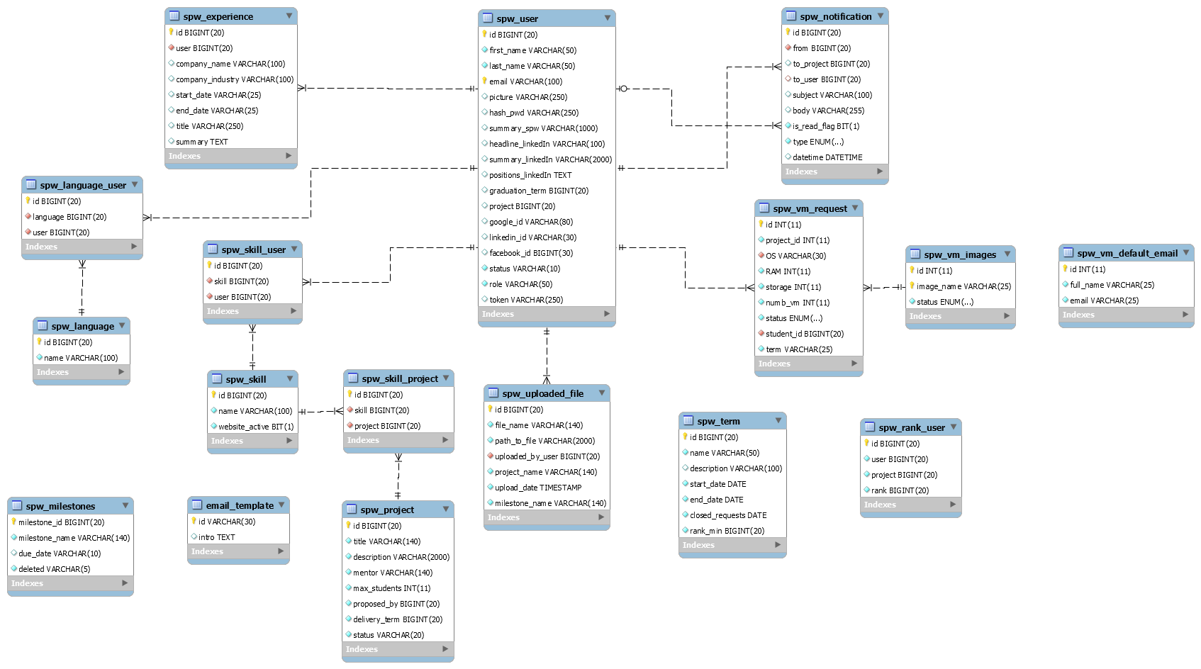
System Design – Persistent Data Design
ER Diagram (did change from V4)
Notes:
Brief explain relation

Slide 12
Security & Privacy
No changes with respect to SPWSv.4
SQL Injection
URI Security
Cross-site scripting (XSS)
Cross-site request forgery (CSRF)
Session Encryption

Slide 13
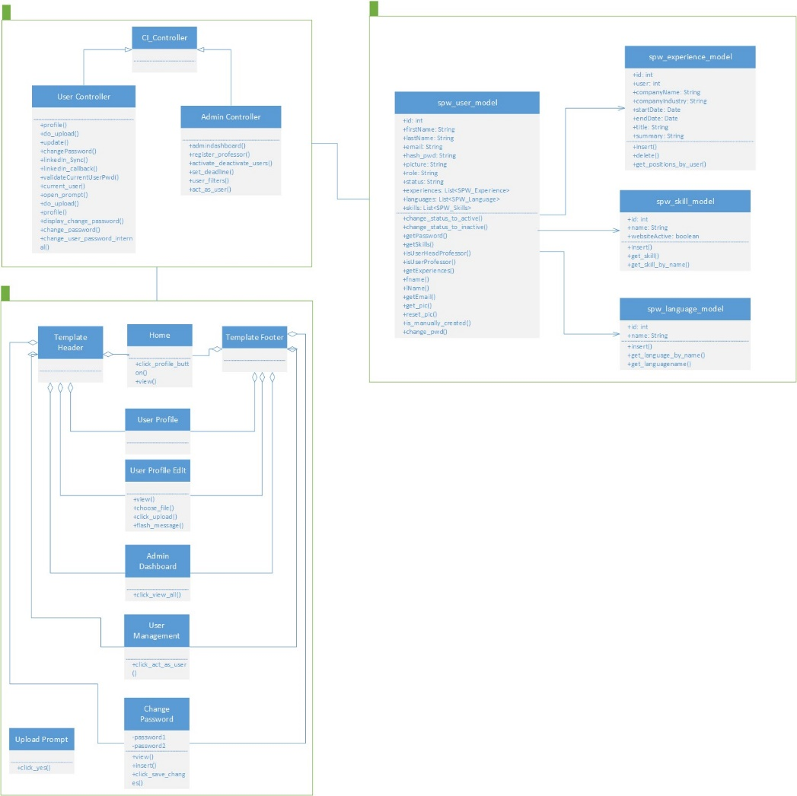
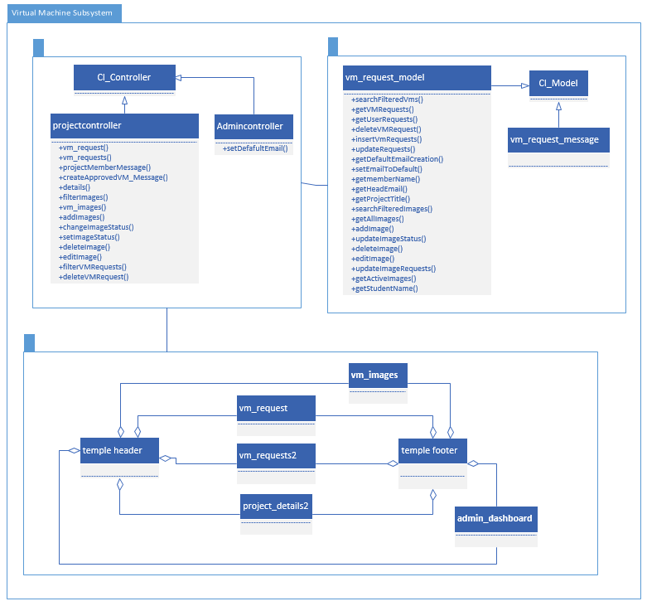
Detailed Design – Minimal Class Diagram
Notes:
brief

Slide 14
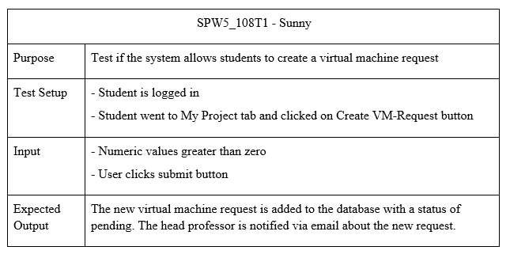
Test Case – Sunny Day
Notes:
brief

Slide 15
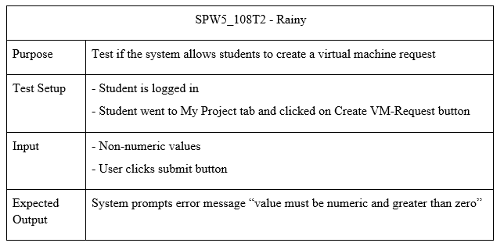
Test Case – Rainy Day

